Slide 1

StackExchange
Pruthvi Billa, Afia Simeen, Zizheng Zhang, Thanmai Reddy

Slide 2
Dataset Overview
Consists of user-contributed content on the Stack Exchange network.
AI, Gaming, History, Movies, Music, and Software engineering are the six chosen sites for our analysis.
Each site archive includes Posts, Users, Votes, Badges, Comments, PostHistory, and PostLinks.
Dataset Size: 3.05GB

Slide 3








Tools

Slide 4
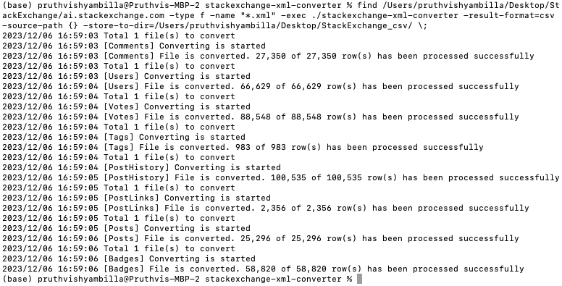
File Conversions
Used the ‘stackexchange-xml-converter’ CLI tool to convert from XML to CSV.

Slide 5
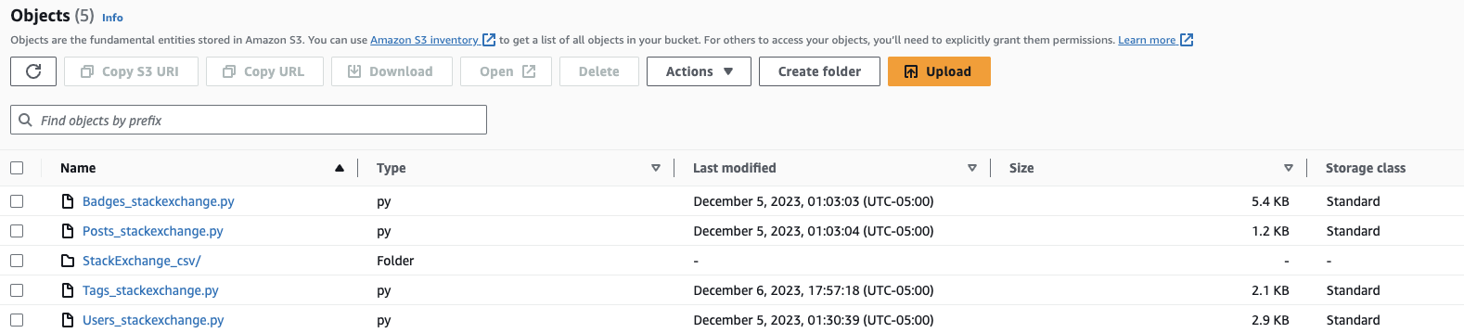
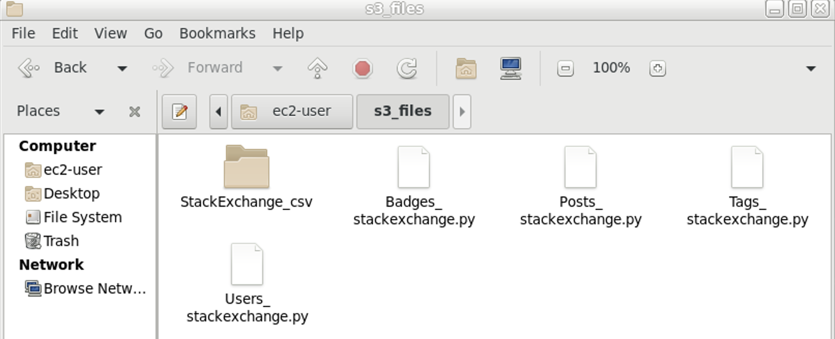
Data Transfer

Slide 6
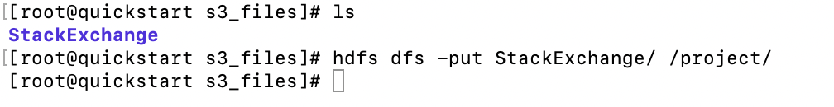
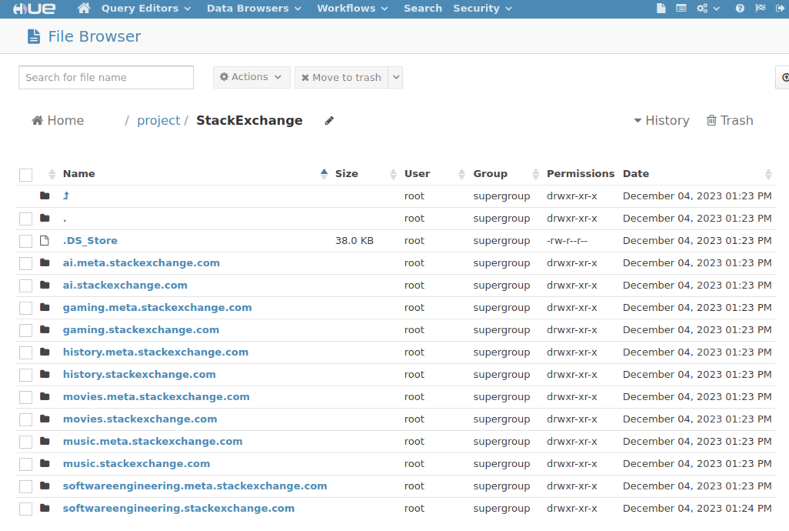
Data Storage

Slide 7
Descriptive Analytics
Platform Growth: How does badge distribution bolster Stack Exchange's user participation and expertise recognition?
Cross-Community Engagement: How can cross-topic engagement data improve community-building across Stack Exchange?
Content & Support Strategy: How does understanding user post volume on Stack Exchange topics enhance the platform's content and support?
Tag Analysis for UX: How can tag frequency analysis refine user experience on Stack Exchange?

Slide 8

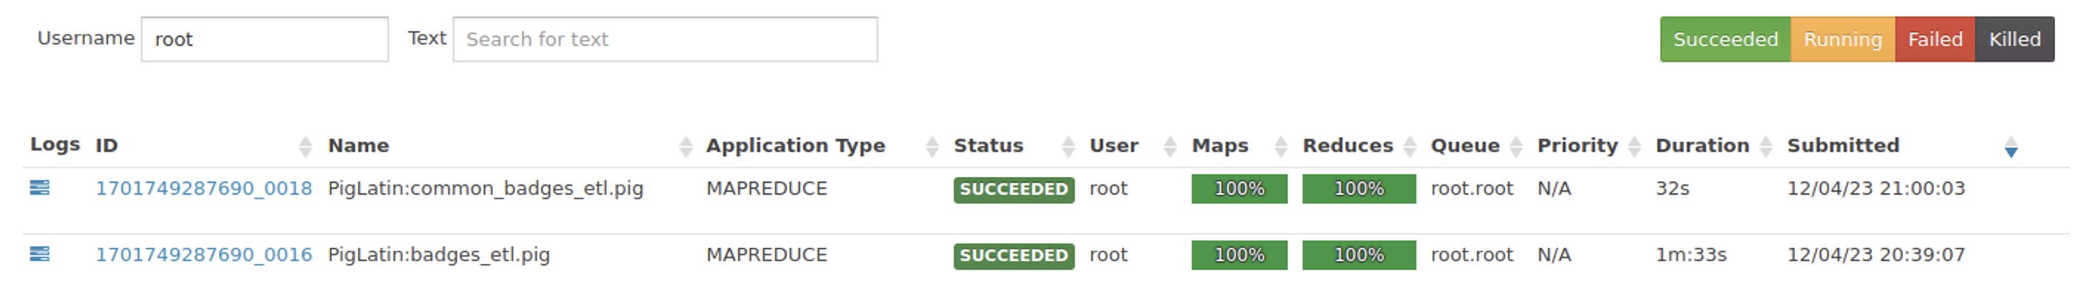
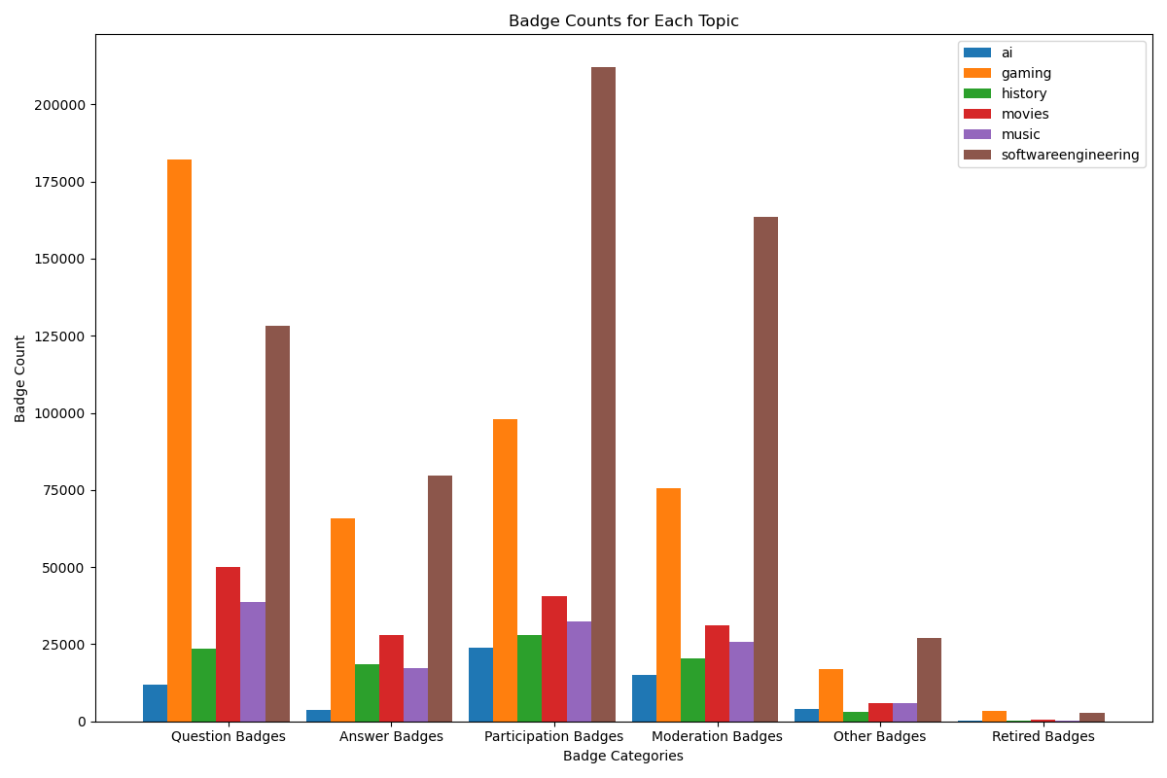
Business Case 1 – Platform Growth
Provide incentives such as enhanced visibility and recognition within the community or even physical rewards for the best answers.
Implement collaborative events, peer sessions, and dedicated platforms to replicate high participation in software engineering across other topics.

Slide 9
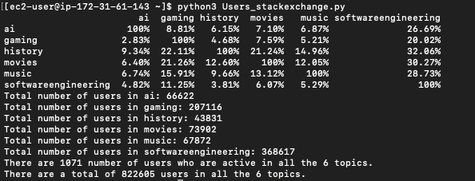
Business Case 2 – Cross Community Engagement
Launch initiatives like cross-topic events, challenges, or discussions that appeal to users with interests in multiple areas.
Provide collaborative spaces to connect users with overlapping interests.

Slide 10
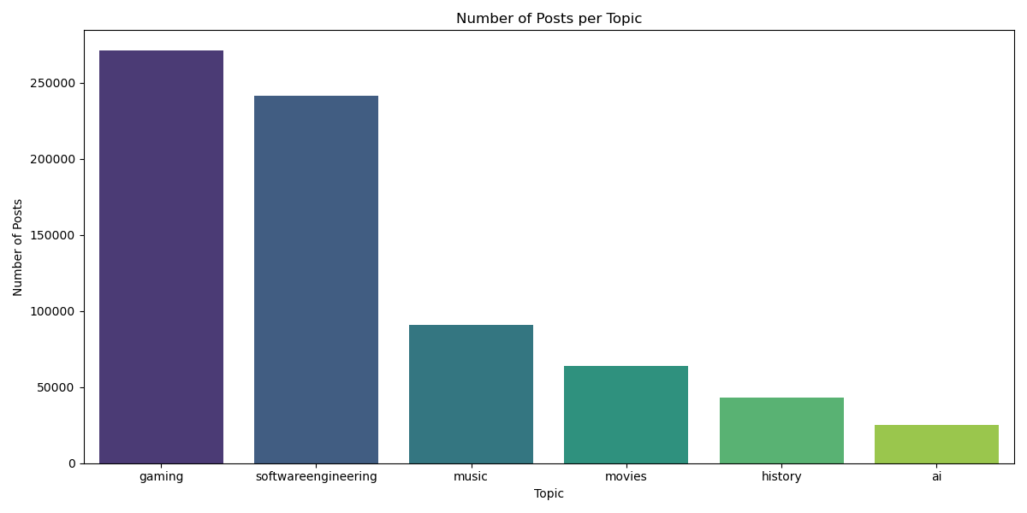
Business Case 3 – Content & Support Strategy
Strategically allocate resources such as time, staff, and money to enhance content and support in areas with the highest engagement, like gaming and software engineering, ensuring that user needs are effectively met.

Slide 11
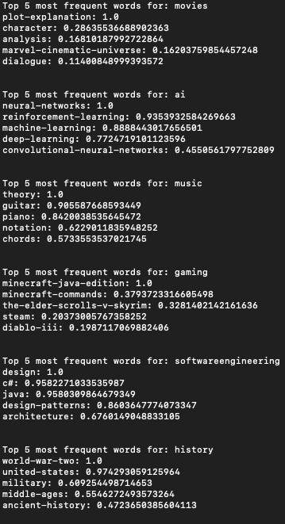
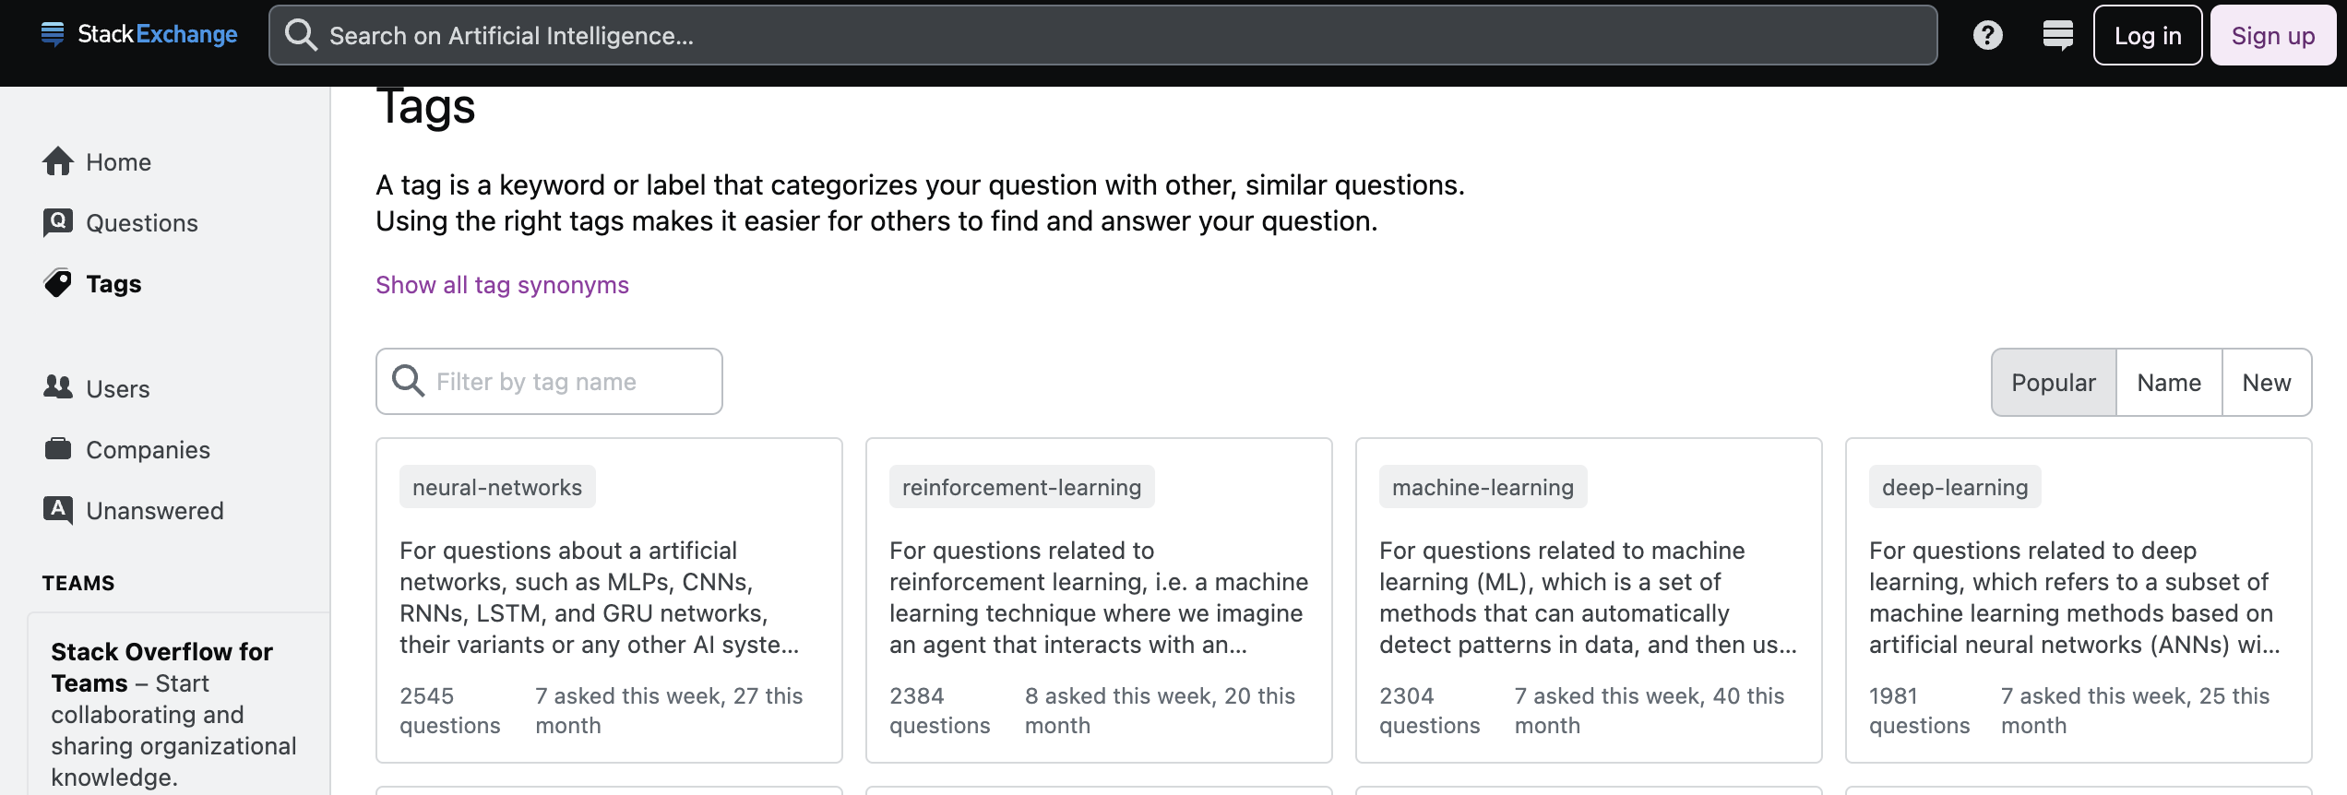
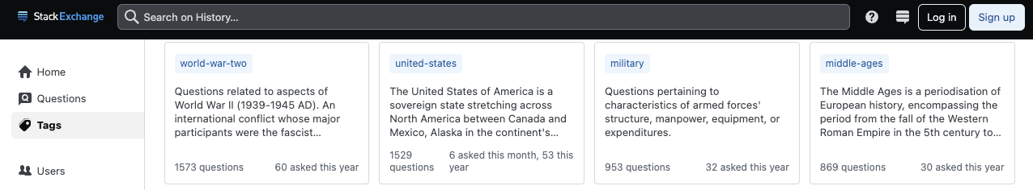
Business Case 4 – Tag Analysis for UX

Slide 12
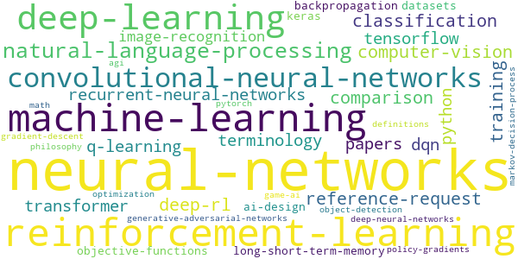
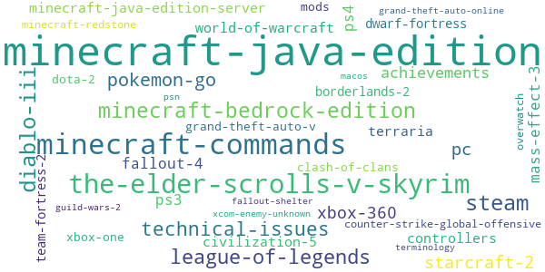
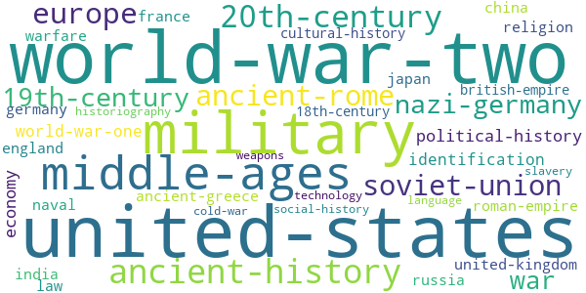
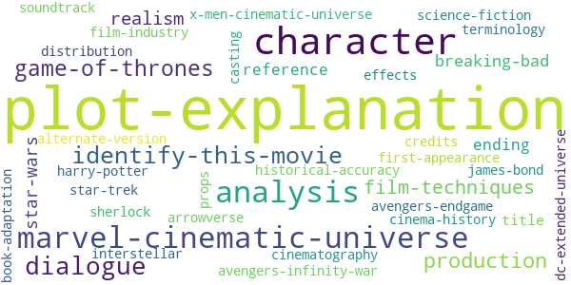
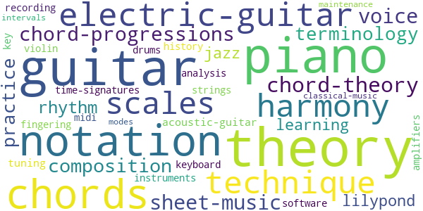
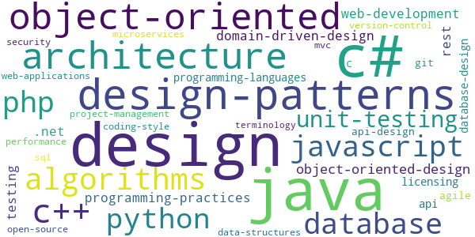
Word Clouds
AI Gaming History
Movies Music Software Engineering
Optimize search and recommendations to surface discussions on popular tags for better information discovery.
Visually emphasizing frequent tags with larger fonts or distinct colors, and featuring them in a 'trending' section, streamlines navigation and facilitates a smoother, more intuitive user experience.

Slide 13
Predictive Analytics - Modelling
Topic Classification: Given a user’s post, predict the topic to which this post belong.
Problem type: Text classification
Reasoning:
All posts under a given topic are relevant.
The relevance could be captured through a statistical approach, i.e., it is statistically learnable.
Anomalies, such as toxic as well as irrelevant posts do not share that relevance.
Anomalies could be identified through the use of a machine learning model.
Business Value:
Improve the contents quality on StackExchange.
Automate part of the censorship workflow and therefore improve productivity.
Utilize the state of the art AI technology.

Slide 14
Predictive Analytics - Implement
Model Selection: BERT Model for Text Classification
A large language model that captures contextual information bidirectionally
Adept at multiclass classification tasks.
Can be fine-tuned to adapt to the nuances of the target classification problem
Training Details:
Hardware: Google Colab T4 GPU (16GB VRAM)
Software: PyTorch, HuggingFace, and other common Python libraries
Dataset: User posts from StackExchange
Loss function: cross entropy
Epoch: 2
Batch size: 16 (owing to limited VRAM)

Slide 15
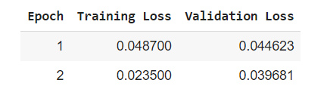
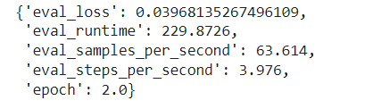
Predictive Analytics - Performance
Decreasing Loss Trends:
Decreasing training loss (0.0487 to 0.0235) indicates effective learning from the training data.
Decreasing validation loss (0.0446 to 0.0397) reflects the model's generalization capability.
Optimal Model Performance:
Converging training and validation losses at low values suggests the model is reaching an optimal state.
The diminishing gap between the two losses also implies good generalization to new, unseen data.
Evaluation Accuracy:
96.9% on sample evaluation dataset.

Slide 16
Predictive Analytics - Examples
A random post from a user (positive case):
I have created a short melody that uses these notes:What mode contains these notes?I have tried Dorian, Aeolian, Lydian, Phrygian and Mixolydian by starting at the scale in each mode that contains all naturals and working up via 5ths. But I can't find a scale that incorporates these notese.f. for Dorian, I started on D, then A, then E, etc. etc.D E F G A B CA B C D E F# GE F# G A B C# DB C# D E F# G# AF# G# A B C# D# EC# D# E F# C# A# B
Model prediction: music
Actual label: music

Slide 17
Predictive Analytics - Examples
A random post from a user (positive case):
I am disappointed by the lack of imagination displayed by my fellow programmers here.It seems to me the client did some research. He may have read somewhere that quality code typically contains about 25% of comments. Obviously he cares/worries about maintenance further down the road. Now, how does he make that concrete in a requirements document that is to be tied to a contract? That is not easy. It may even be impossible…(truncated)
Model prediction: software engineering
Actual label: software engineering

Slide 18
Predictive Analytics - Examples
A random post from a user (negative case):
According to this unofficial wiki:Jeanne was captured by English troops, accused of witchery, and burned at the stake on May 31 1431, at the age of 19. However, the Templar Order had orchestrated her execution in order to steal her Sword.An ancestor of Warren Vidic was present at the trial and execution.Since the Templars apparently orchestrated her execution, it is very likely they already knew about the Sword beforehand.
Model prediction: gaming
Actual label: history

Slide 19
Predictive Analytics - Examples
A random post from a user (negative case):
Why did algorithm S do better at beating humans than algorithm H? Because S was a better model of human behaviour. The obvious difference is that S (Shannon) had a short memory and H (Hagelbarger) had one that was longer. We can hypothesise that humans play this game with more short term than long term consistency. Obviously to check our hypothesis will require more experiments.Why did algorithm S beat algorithm H? … (truncated)
Model prediction: software engineering
Actual label: AI

Slide 20
Predictive Analytics - Deliverables
Tuned model available at HuggingFace Hub
Repo Id: Chaconne/BDAI
Repo link: https://huggingface.co/Chaconne/BDAI
Demo notebook:
https://colab.research.google.com/drive/1iGJXVLkDsLqhZrPYkltGbMovpT1xPNht#scrollTo=9sdV93cyQHhK

Slide 21
Predictive Analytics - Limitation
Original schedule was to train the model on A100 GPU with 40GB VRAM.
Owing to unavailability to high-performance computation resource, only a small portion of the original dataset (58,881 rows) were used in training to accommodate the mere 16 GB GPU memory.
Based on the loss information, the model has not yet been tuned to its optimal state.
Model is prune to mistakes when trying to predict closely related topics.

Slide 22
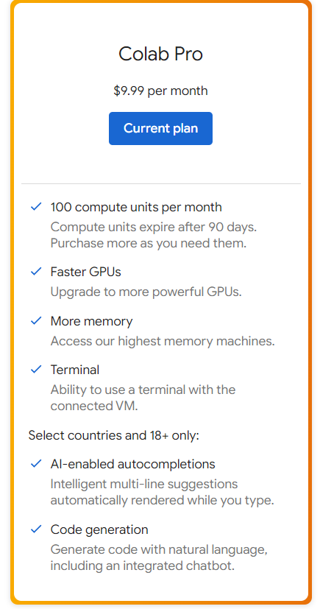

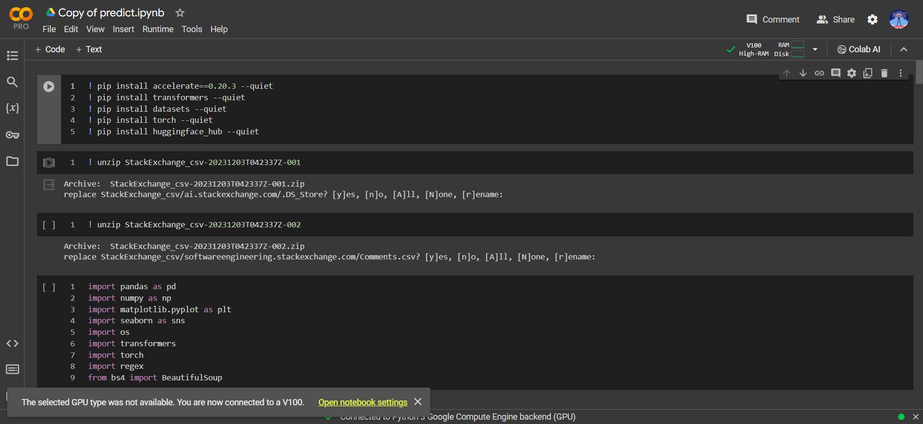
Predictive Analytics - Limitation
Screenshots demonstrating unexplained unavailability of desired computing resource. (planned A100 with 40GB but got just V100 with 16GB)

Slide 23
Conclusion
Successfully fine tuned a large language model that classifies Stack Exchange posts, improving the contents quality and reducing human labor cost.
Conducted a comprehensive user behavior analysis to strategically allocate resources.
Revealed correlations between user activity and topic preferences, providing a basis for focused cross community engagement.
These insights offer Stack Exchange data-driven strategies to optimize user experience and drive platform growth.

Slide 24
Thank You

